Slide 1
Practice Patterns and the Role of Testosterone In Prostate Cancer
ABBV-US-00608-MC V 1.0
Approved 9/2021

Slide 2
Role of Testosterone In Prostate Cancer
The prescribing information for all FDA-approved GnRH agonists suggest monitoring testosterone levels to ensure castrate testosterone levels are maintained¹
Review data on the importance of monitoring testosterone in patients with prostate cancer who are on androgen deprivation therapy (ADT)
Impact of testosterone escape as it relates to disease progression and overall outcomes²
Understand the relationship between testosterone and prostate specific antigen (PSA)
1.Drugs@FDA: FDA Approved Drug Products website. https://www.accessdata.fda.gov/scripts/cder/daf/. Accessed November 12, 2019 2.Wilke D et al. Pharmacotherapy. 2018;38(3):327-333

Slide 3
Testosterone: Defining Castration Levels
The US FDA defines medical castration as testosterone levels below 50 ng/dL (ie, 1.735 nmol/L)¹
Clinical studies have shown testosterone levels to be 20 ng/dL (ie, 0.694 nmol/L) or lower following surgery^{1,3,4}
Median testosterone level post-orchiectomy was 15 ng/dL (0.5 nmol/L; 95% CI 12-17 ng/dL)⁵
Median testosterone level 12 months post-orchiectomy was 16 ng/dL (95% CI 10-22 ng/dL)⁶
The Bethesda consensus recommend a threshold for serum testosterone after ADT to be 20 ng/dL (ie, 0.69T4 nmol/L)²
The clinical benefits of maintaining testosterone levels <20 ng/dL versus <50 ng/dL have not been prospectively studied
ADT, androgen deprivation therapy; CI, confidence interval.
References: 1. Oefelein MG et al. J Urol. 2000;164:726-729. 2. Djavan B et al. BJU Int. 2011;110:344-352. 3. Lin B et al. Urology. 1994;43:834-837. 4. Vogelzang NJ et al. Urology. 1995;46:220-226. 5. Oefelein MG et al. Urology. 2000;56(6):1021-1024. 6. Røhl HF, Beuke HP. Scand J Urol Nephrol. 1992;26(1):11-14.

Slide 4
Morote et al: Redefining clinically significant castration levels in patients with prostate cancer receiving continuous androgen deprivation therapy
A
S
S
E S S M
E
N
T
(n=28)
Objectives:
Primary objective: Determine the lowest serum testosterone level with a clinically relevant impact on time to androgen independent progression (AIP)/Castrate Resistant Prostate Cancer (CRPC)
Secondary objective: Evaluate the effect of continuing bicalutamide with GnRH agonists on castration escapes
GnRH agonist Q3 months + Antiandrogen QD
Lead-in
(N=73)
Median follow-up 54.1 months
(range 12-240 months)
Antiandrogen QD
x 2 weeks
(n=45)
GnRH agonist Q3 months
PSA + testosterone measured Q6 months^{a,b}
Potential Clinical Consequences of Testosterone Escape
A hormonal escape was defined as an increase in serum testosterone >50 ng/dL after castration levels were achieved.
ªSamples collected 8 to 12 weeks following GnRH agonist administration (between 8 am and 10 am).
^{b}Testosterone levels determined using a chemiluminescent assay (lower detection limit <15 ng/dL).
QD, every day; Q3, every three months; Q6, every six months.
Reference: Morote J et al. J Urol. 2007;178:1290-1295.
Notes:
CRPC is defined as 3 consecutive PSA increases after nadir
When the first increase in PSA was detected, 2 more PSA determinations were performed in the following 2 months
Survival free CRPC was established as the period between the day of the first LHRH agonist injection and the day of the first PSA increase after the nadir PSA

Slide 5
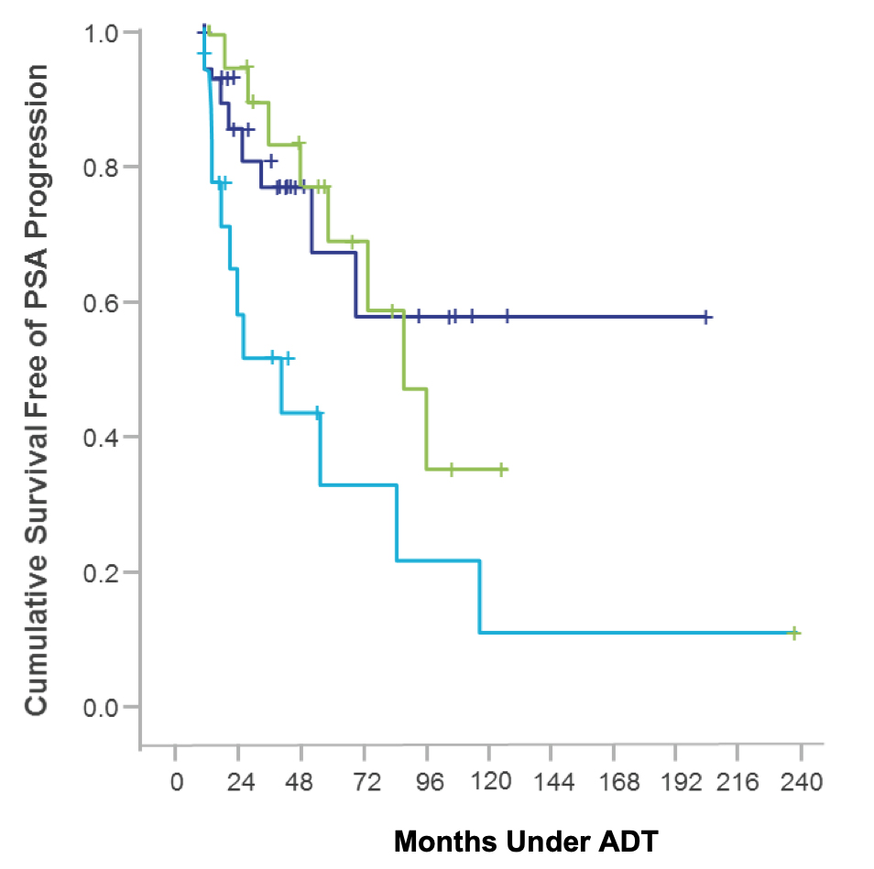
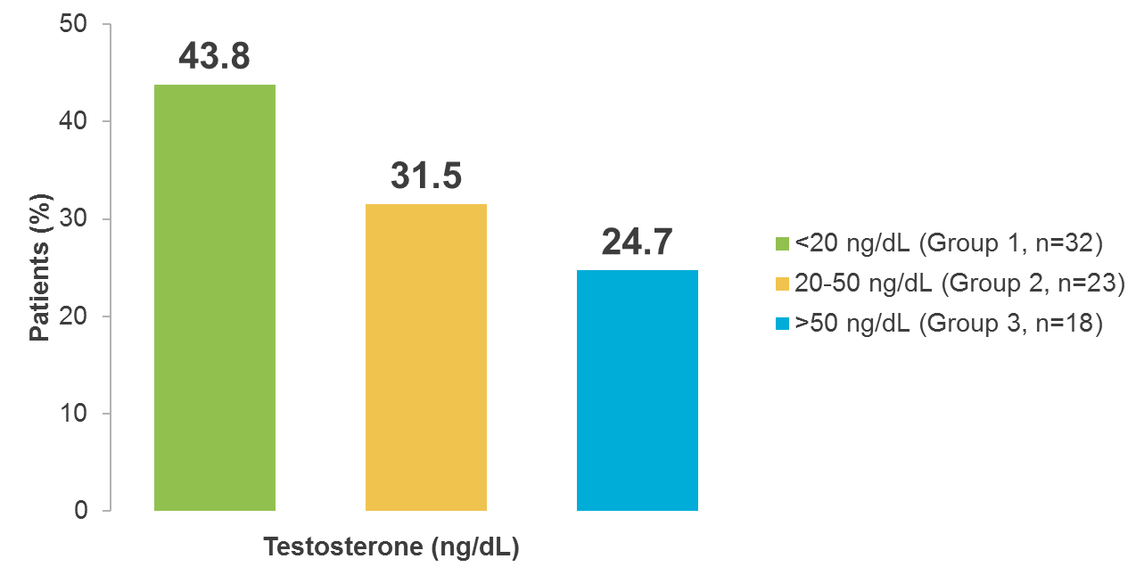
Morote et al: Fewer Escapes and Lower Testosterone Reduce Incidence of CRPC
Testosterone Analysis of 3 Consecutive Measurements at 6-Month Intervals
P=0.0207
Mean survival=106 months
<20 ng/dL (Group 1, n=32)
Group 1 (<20 ng/dL, ie, <0.694 nmol/L)
20-50 ng/dL (Group 2, n=23)
Mean survival=90 months
>50 ng/dL (Group 3, n=18)
Group 2 (20-50 ng/dL)
Patients (%)
Mean survival=72 months
Group 3 (>50 ng/dL, ie, >1.735 nmol/L)
Testosterone Groups (ng/dL)
N=73
Months Under ADT
Reference: Morote J et al. J Urol. 2007;178:1290-1295.
Notes:
CRPC is defined as 3 consecutive PSA increases after nadir
When the first increase in PSA was detected, 2 more PSA determinations were performed in the following 2 months
Survival free CRPC was established as the period between the day of the first LHRH agonist injection and the day of the first PSA increase after the nadir PSA

Slide 6
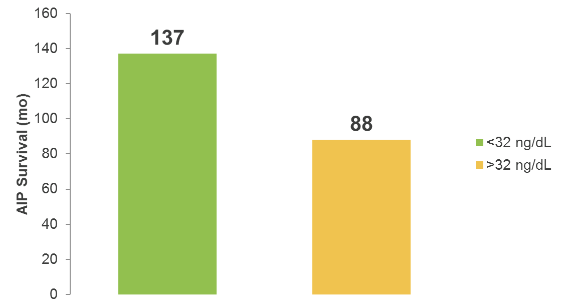
Morote et al: Testosterone Levels Inform CRPC/AIP
Conclusion
Monitoring testosterone is an important part of clinical practice when evaluating effects of hormonal therapy
There is a need to routinely evaluate testosterone level when initiating and following ADT
To obtain maximal androgen blockade, following a patient’s testosterone levels would allow redosing the LHRH agonists accordingly
P=0.03
N=73
Mean AIP Survival (mo)
Testosterone Groups (ng/dL)
Lowest serum testosterone threshold that significantly distinguish groups related with the survival free of AIP was 32 ng/dL
mo, months.
Reference: Morote J et al. J Urol. 2007;178:1290-1295.
Notes:
Morote et al: Conclusions
Monitoring testosterone is an important part of clinical practice when evaluating effects of hormonal therapy
There is a need to routinely evaluate testosterone level when initiating and following ADT
To obtain maximal androgen blockade, following a patient’s testosterone levels would allow redosing the LHRH agonists accordingly
“In the subset of patients on maximal androgen blockage the rate of breakthrough increases of serum testosterone greater than 50 ng/dl was 75.6%, similar to 75% in those patients treated with medical castration”
“The clinical impact of ADT modality in those in whom breakthrough increases of serum testosterone developed at some point was analyzed. Taking the conventional threshold of 50 ng/dl, mean survival free of PSA progression was 115 months when receiving maximal androgen blockade as opposed to 32 months when receiving LH-RH agonist alone”

Slide 7
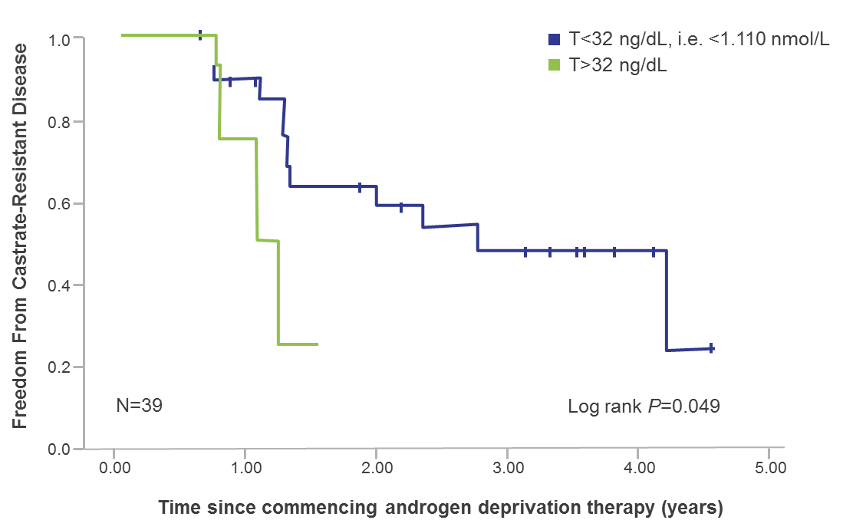
Dason et al: Defining a new testosterone threshold for medical castration: Results from a perspective cohort series
Time to CRPCª Based on Mean Testosterone Levels Through 12 Months
Objectives:
Determine if testosterone levels below the historic castration threshold (50 ng/dL) have an impact on time to progression to CRPC
32 patients undergoing ADT with LHRH agonist or antagonist were followed for a mean of 26 months.
After initiation of ADT, PSA and testosterone were measured every 3 months for the duration of the study.
T<32 ng/dL, ie, <1.110 nmol/L
T32-50 ng/dL
N=32
ªPatients were considered to have progressed to CRPC when there were at least 2 consecutive rises in PSA above nadir, clinical progression, or death from disease.
T, testosterone Patients with any testosterone >50 ng/dL were excluded
Reference: Adapted from Dason S et al. Can Urol Assoc J. 2013;7(5-6):e263-e267.

Slide 8
Dason et al: Conclusions
Lower testosterone threshold for medical castration during ADT may play a clinically significant role in delaying CRPC
Testosterone level in the first year following initiation of ADT may serve as an early predictor of disease progression
9-month absolute testosterone <32 ng/dL (ie, 1.110 nmol/L) compared to 32-50 ng/dL had an increased time to CRPC (P=0.001)
1-year mean testosterone <32 ng/dL compared to 32-50 ng/dL had a significantly increased time to CRPC (P=0.05)
Reference: Dason S et al. Can Urol Assoc J. 2013;7(5-6):e263-e267.

Slide 9
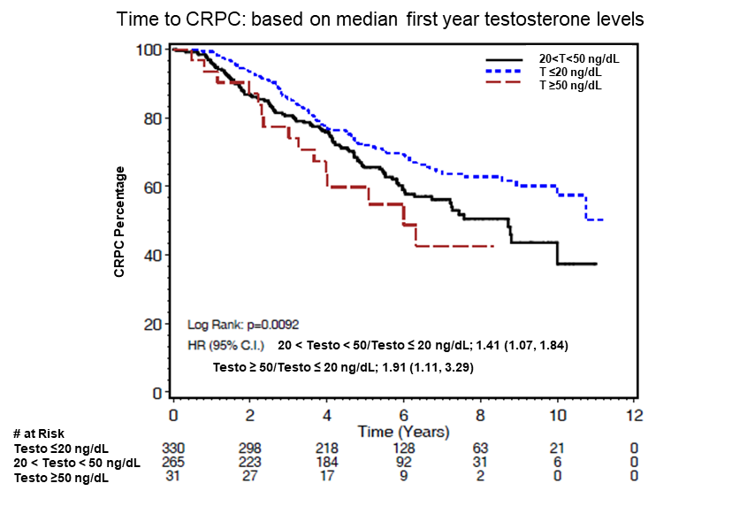
Klotz et al: Nadir testosterone within first year of androgen-deprivation therapy (ADT) predicts for time to castration-resistant progression: a secondary analysis of the PR-7 trial of intermittent versus continuous ADT
Nadir Testosterone on ADT Predicts Time to CRPC
Objectives:
Determine if a higher nadir testosterone value in the first year of ADT correlates with a reduced time to development of CRPC and lower CSS
Patients (n=626) randomly assigned to CAD were included in this analysis.
Testosterone was measured every 2 months in the first year
HR, hazard ratio. CSS, cause specific survival.
CRPC, castrate resistant prostate cancer. CAD, continuous androgen deprivation
Reference: Klotz L et al. J Clin Oncol. 2015;33(10):1151-1156.
Notes:
Median testosterone level (nmol/L) time to CRPC:
< 0.7 NR
0.7 to 1.7 8.72 years
> 1.7 6 years
Minimum testosterone level (nmol/L) time to CRPC:
< 0.7 10 years
0.7 to 1.7 7.21 years
> 1.7 3.62 years

Slide 10
Klotz et al: Conclusions
Patients with mean testosterone >20 ng/dL had a significantly
higher risk of developing CRPC
T 20 to 50 ng/dL: HR 1.41 [95% CI 1.07-1.84]
Patients with nadir (minimum) testosterone >20 ng/dL had a significantly
higher risk of dying as a result of disease
T 20 to 50 ng/dL: HR, 2.08; 95% CI, 1.28 to 3.38
T ≥50 ng/dL: HR, 2.93; 95% CI, 0.70 to 12.30
Serum testosterone should be assayed regularly in such patients, and ADT modified to ensure levels <20 ng/dL are achieved
T ≥ 50 ng/dL: HR 1.91 [95% CI 1.11-3.29]
T, testosterone
Reference: Klotz L et al. J Clin Oncol. 2015;33(10):1151-1156.
Notes:
Median testosterone level (nmol/L) time to CRPC:
< 0.7 NR
0.7 to 1.7 8.72 years
> 1.7 6 years
Minimum testosterone level (nmol/L) time to CRPC:
< 0.7 10 years
0.7 to 1.7 7.21 years
> 1.7 3.62 years

Slide 11
Wilke et al: Testosterone Suppression with Luteinizing Hormone-Releasing Hormone (LHRH) Agonist in Patients Receiving Radiotherapy for Prostate Cancer
To characterize the probability of testosterone escape during a course of radiotherapy and ADT in patients with prostate cancer
A retrospective chart review of 361 patients with nonmetastatic prostate cancer who were treated with ADT and RT were followed for a median of 4.7 years.
Examine:
Predictors of testosterone escape
PSA levels during testosterone escape
The impact of testosterone escape on outcomes
Patients had a median of 6 testosterone measurements
Reference: Wilke D et al. Pharmacotherapy. 2018;38(3):327-333.

Slide 12
Wilke et al: Distribution of Testosterone
Younger age was a predictor for patients having higher maximum testosterone values during their course of ADT
ªAnalysis of variance test, on maximum testosterone comparison.
Reference: Wilke D et al. Pharmacotherapy. 2018;38(3):327-333.

Slide 13
Wilke et al: Distribution of PSA Values at Time of Testosterone Escape
PSA at the time of testosterone escape (>1.75 nmol/L ie, 50 ng/dL) was relatively low
69 testosterone escapes in 50 patients
Reference: Wilke D et al. Pharmacotherapy. 2018;38(3):327-333.
Notes:
Age and number of testosterone measurements were statistically significant to predict testosterone suppression
Of the 13.8% of patients in the cohort that experienced a testosterone escape, those patients < 67.5 of age accounted for 9.1% of escape events, whereas older patients accounted for only 4.7% of events,
nearly half the rate of testosterone escape in the patients whose age was <67.5

Slide 14
Wilke et al: Retrospective Review Conclusions
The incidence of testosterone escape is higher in younger patients and in patients with more frequent monitoring of serum levels of testosterone
In patients with <6 testosterone measurements, the probability of testosterone escape was 0%–9% across LHRHa treatments, whereas in patients with >6 measurements the probability of testosterone escape was in the range of 10%–26%.
An undetectable PSA does not rule out the presence of higher than desired levels of testosterone, reinforcing the need to monitor testosterone levels, especially in younger patients
Reference: Wilke D et al. Pharmacotherapy. 2018;38(3):327-333.
Notes:
An estimated 6%-13% of patients’ serum testosterone levels can go above 50 ng/dL (1.74 nmol/L), resulting in what is commonly known as testosterone escape
The incidence of Testosterone escape per patient course of treatment on all GnRHas varied between 6.7% to 23.9%.

Slide 15
Perachino et al: Testosterone levels in patients with metastatic prostate cancer treated with luteinizing hormone-releasing hormone therapy: prognostic significance?
Patient Characteristics (n=129)
Variable | Mean (SD), median (IQR) (range)
Age, years | 74.6 (6.7), 75 (52-88) (70-80)
Testosterone, ng/dL Baseline 6-months Nadir Months to nadir | 440 (200), 410 (67-1160) (305-539) 40 (40), 29 (4-280) (17.5-50.5) 185.8 (344.1), 54.0 (3.7-1879) (24.25-150.7) 17.1 (126.4), 0.22 (0.02-1425) (0.08-2.91)
PSA, ng/mL Baseline 6-months Nadir Months to nadir | 21 (15), 9 (1-79) (10-28) 13.9 (17.7), 16 (3-96) (3-14) 2.7 (8.6), 0.1 (0.01-72.8) (0.06-0.88) 9.5 (7.7), 6 (1-45) (6-12)
Follow-up, months | 47.5 (29.7), 40 (6-120) (22-72)
Objective
Determine if the testosterone level achieved with ADT is directly related to survival and risk of death in men with metastatic prostate cancer
IQR, interquartile range; SD, standard deviation.
Reference: Perachino M et al. BJU Int. 2010;105(5):648-651.

Slide 16
Perachino et al: Correlation Between the Risk of Death and Testosterone During ADT
Gleason score distribution of 129 patients
Hazard ratios and related 95% Cl
Gleason score | n (%)
4-6 | 38 (29.5)
7 | 43 (33.3)
8-9 | 48 (37.2)
Total | 129 (100)
6m testosterone (mean 40 ng/dL)
6m PSA (mean 13.9 ng/dL) P<0.01
Age (mean 74.6 years)
Conclusion
Mean testosterone (40 ng/dL) at 6 months was shown to have value in predicting survival (P<0.050)
m, months; CI, confidence interval..
Reference: Perachino M et al. BJU Int. 2010;105(5):648-651.

Slide 17
Conclusion: Role of Testosterone In Prostate Cancer
Recap
FDA defines medical castration as testosterone levels below 50 ng/dL (ie, 1.735 nmol/L)¹
The Bethesda consensus recommend a threshold for serum testosterone after ADT to be 20 ng/dL (ie, 0.694 nmol/L)²
Regularly checking testosterone levels while patients are on ADT is important for prostate cancer disease management
The prescribing information for all FDA-approved GnRH agonists suggest monitoring testosterone levels to ensure castrate testosterone levels are maintained
Inadequate testosterone suppression appears to predict a greater likelihood of, and shorter time to CRPC/AIP and higher risk of dying as a result of disease
References: 1. Oefelein MG et al. J Urol. 2000;164:726-729. 2. Djavan B et al. BJU Int. 2011;110:344-352 3. Hussain M et al. N Engl J Med. 2018;378(26):2465-2474. 4. Fizazi et al. N Engl J Med. 2017;377:352-60.

Slide 18
Thank you

